Slide 1
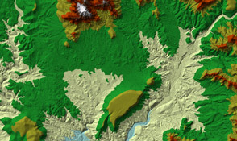
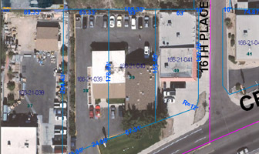
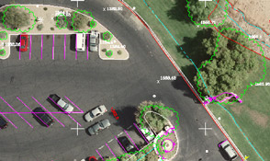
Mapping Technology Overview
Philip Gershkovich
President
Cooper Aerial Surveys Co.
Copyright 2016

Slide 2
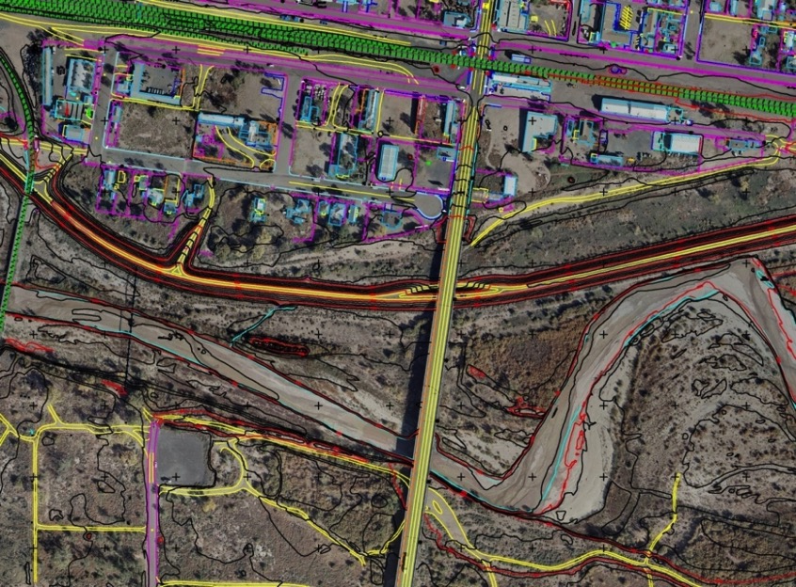
Agenda
Overview
Ground Truth
Data Acquisition
GIS

Slide 3
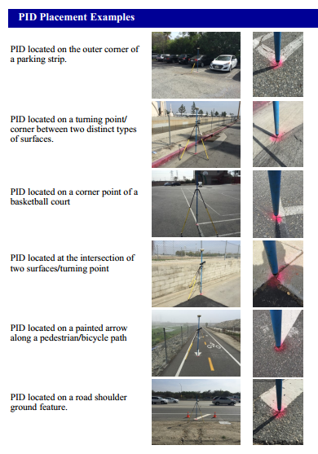
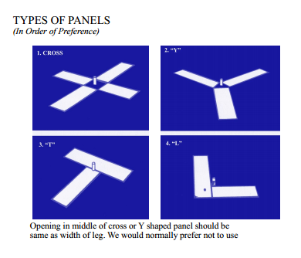
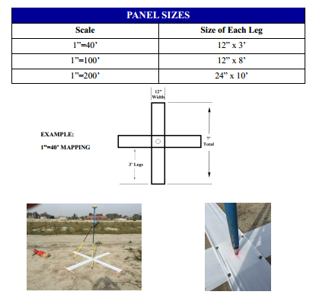
Ground Control
Notes:
3

Slide 4
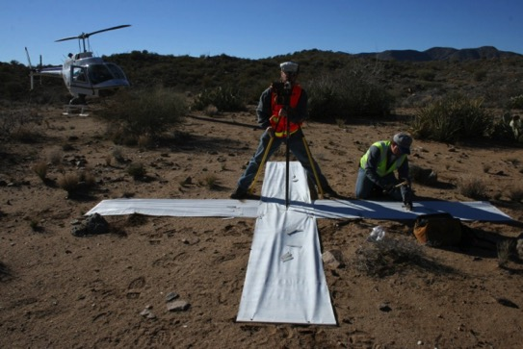
Aerial Target Control/Survey
Ground Control
Surveyed to within 1/10 contour interval or better
Basis/Datum?
Verify elevations are ground elevations.
Blind Panels
Digital Mapping Limits
In control coordinates
Corridor width
How long do panels last?
Best Practice
Ground Truthing
Supplemental Topo
Notes:
4

Slide 5
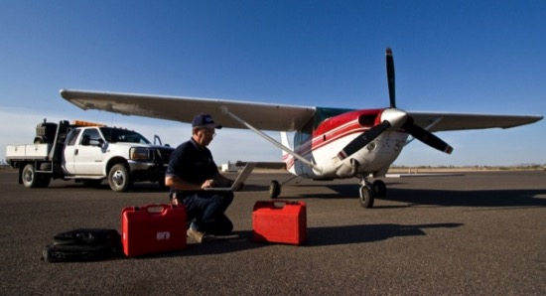
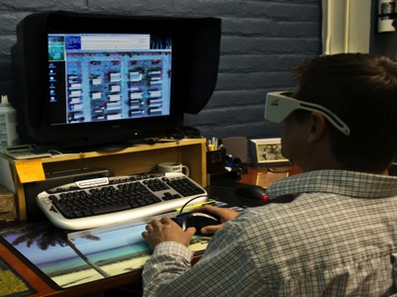
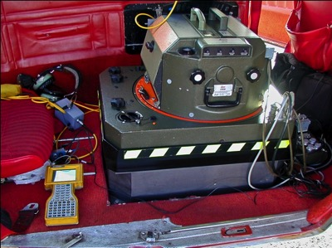
Remote Sensing
The acquisition, collection of information about the earth without making physical contact.
Photogrammetry – science of making measurements from photographs

Slide 6
Work Flow Processes
Assess Needs
Is aerial mapping/required
Project Scope
Flight
Aerial Triangulation
Compilation
Editing & QC
Ortho-Rectification

Slide 7
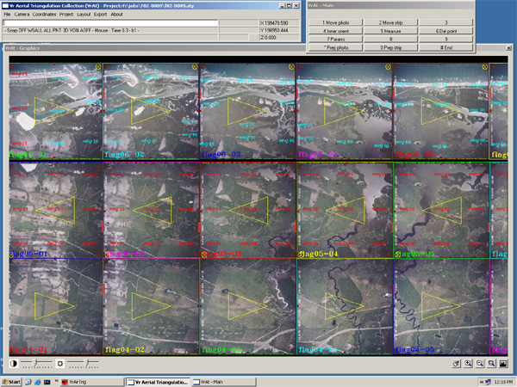
Aerial Triangulation
Mathematical process used to determine the position and orientation of each photograph at the moment of exposure
Image measurements to ground coordinates
Critical step related to quality

Slide 8
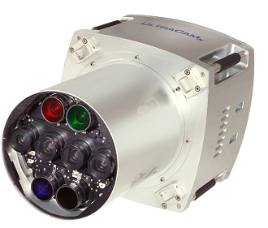
Survey Camera

Slide 9
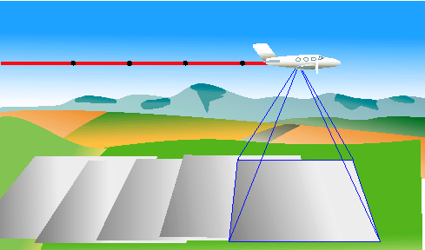
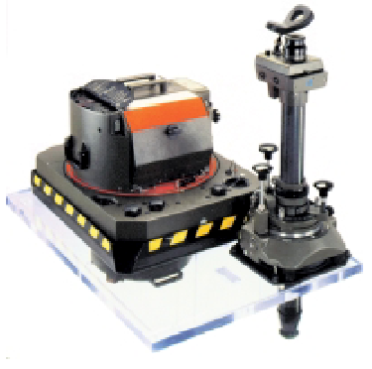
Flight

Slide 10
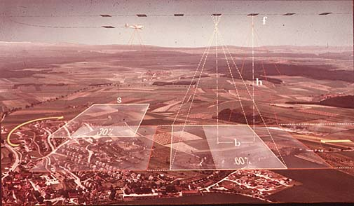
Flight

Slide 11
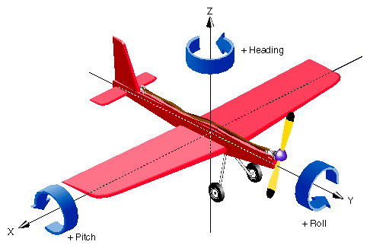
Flight Conditions
Roll, Pitch and Yaw
Roll is the rotation about the
y axis
Pitch is the rotation about the
x axis
Yaw is the rotation about the z axis
Roll and Pitch is corrected by ABGPS
And IMU
The camera to be used must be equipped
with Forward Motion Compensation
(FMC) to Correct for Yaw.
The optical axis of the camera will be as near vertical as possible and in no case shall the tilt exceed 3 degrees. The tilt between two consecutive exposures shall not exceed 4 degrees.

Slide 12
Flight Conditions Cont.
Time of day for flight will be when shadows caused by topographic relief, and sun angle will be near minimum, and at low tide. Excessive and deep shadows may be cause for rejection of photography. Sun angle shall not be less than 40 degrees.
The aerial Photography will be acquired under leaf-off conditions and will take place in November to December to achieve these results.

Slide 13
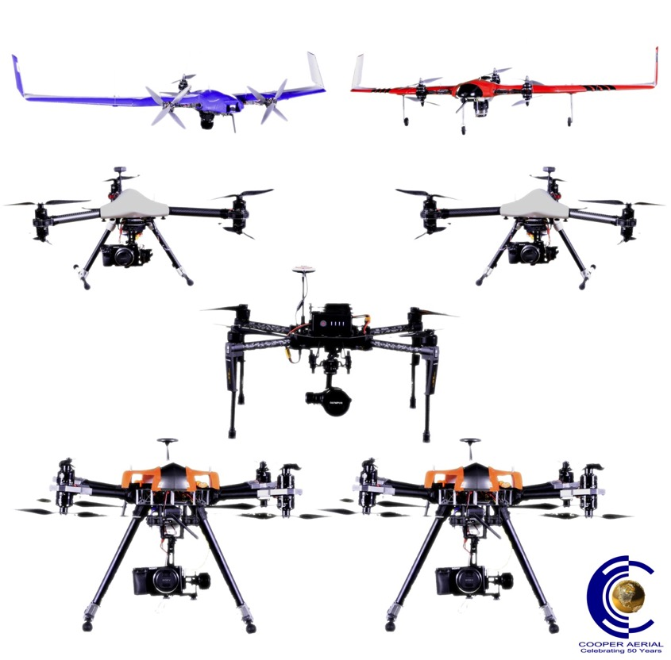
Drones

Slide 14
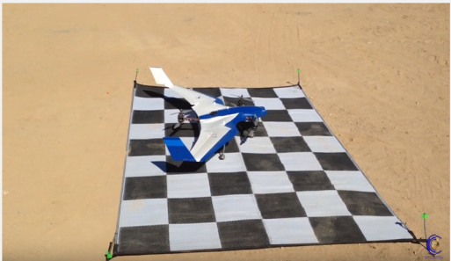

Slide 15
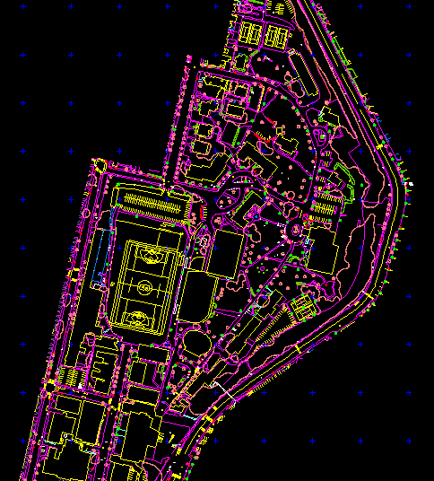
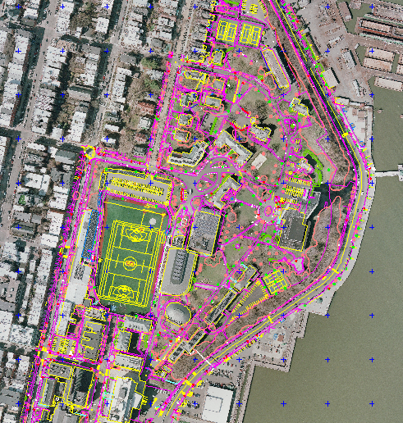
2D Data
Remote Sensed Imagery
Planimetrics

Slide 16
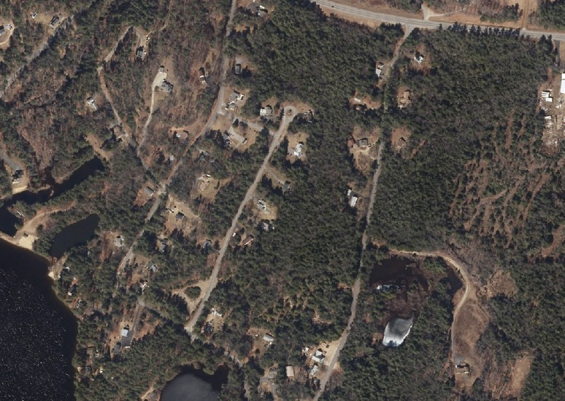
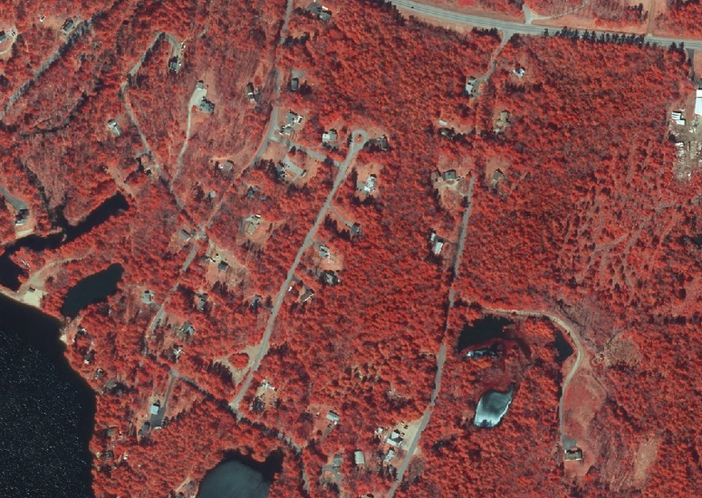
RGB
NIR

Slide 17
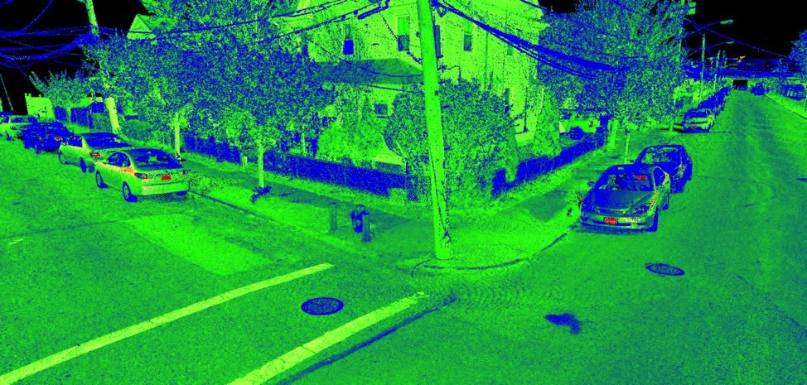
3D Data
Digital Surface Model
Digital Terrain Model
Triangulated Irregular Network
Orthorectified Imagery
Contours
LiDAR

Slide 18
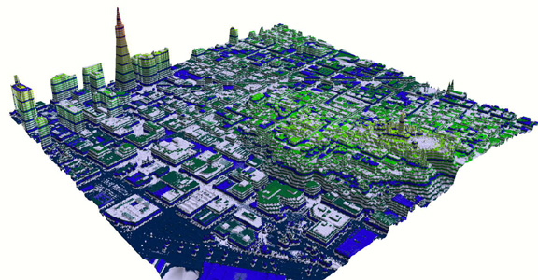
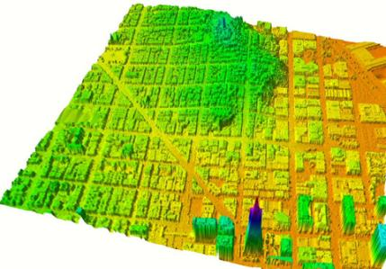
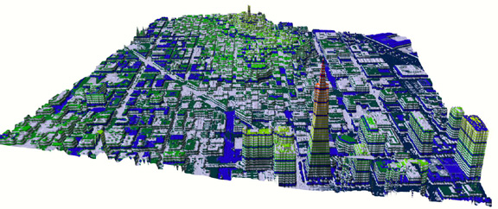
LiDAR
Analyzing
Multiple Features:
Man-made
Geographic
Vegetation
Notes:
18

Slide 19
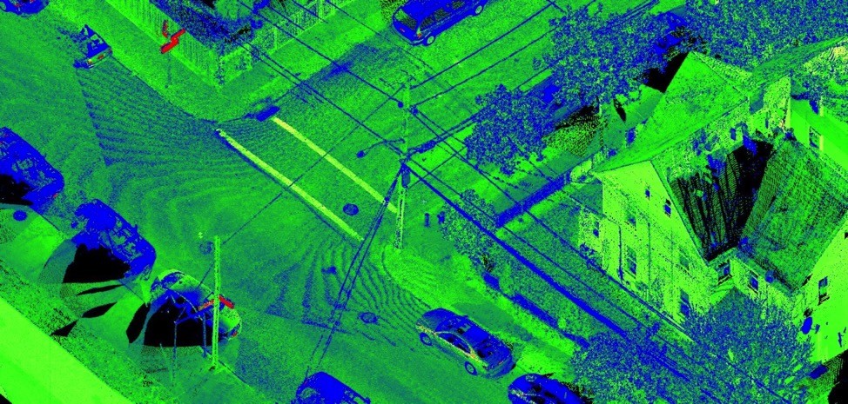
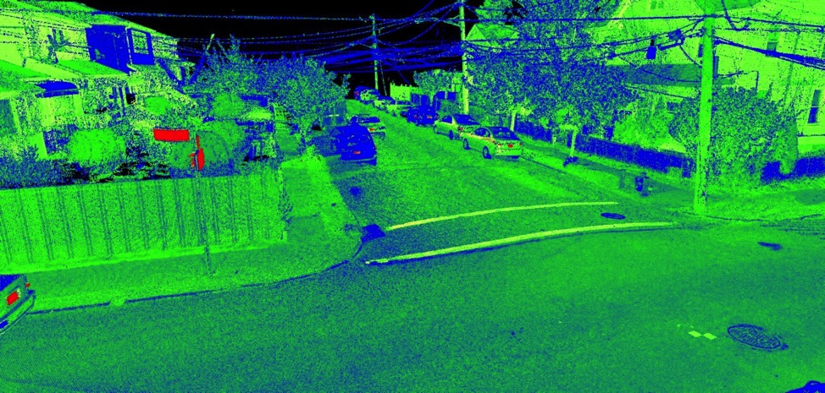

Slide 20
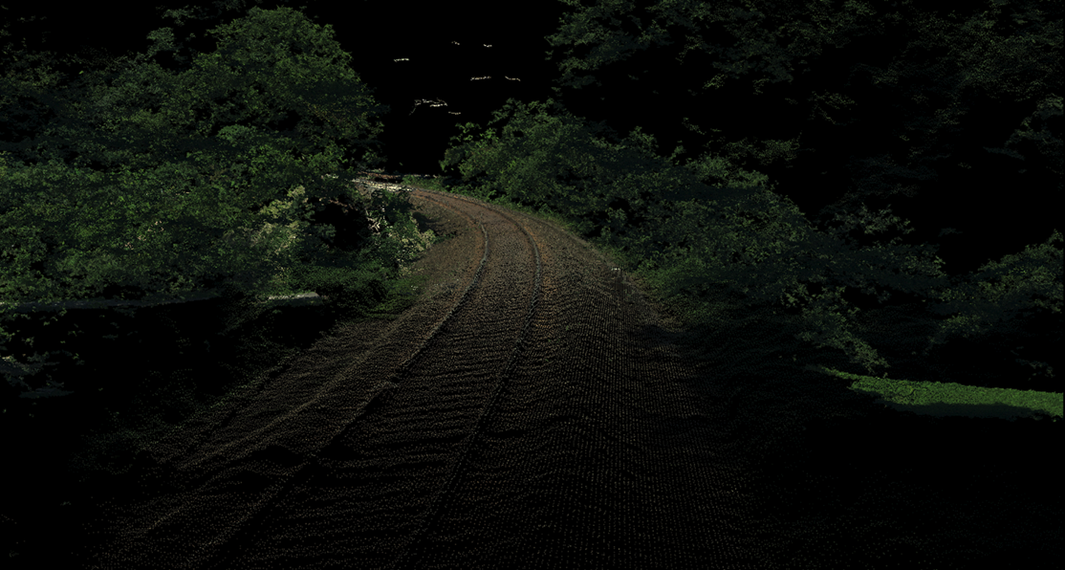
Processing
Pixel to point cloud
Photos are now converted to point clouds which function similarly as LiDAR data

Slide 21
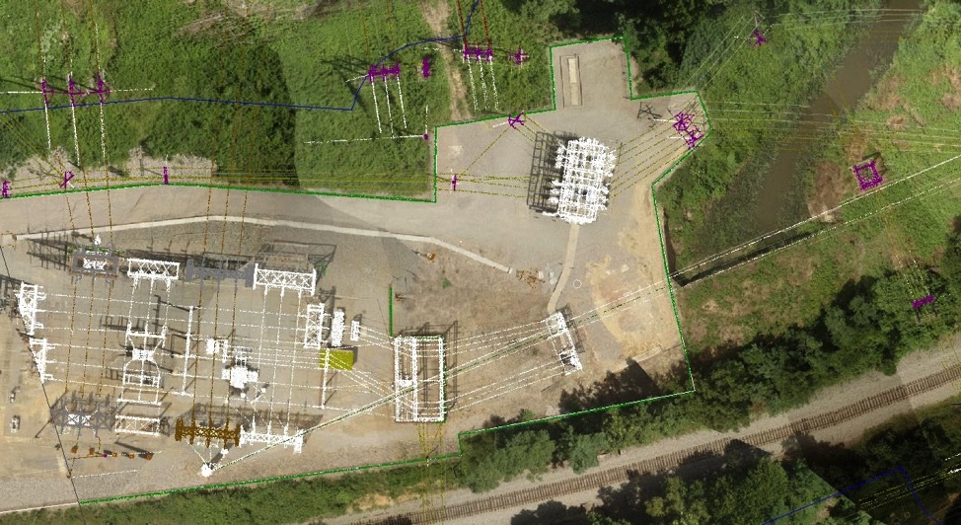
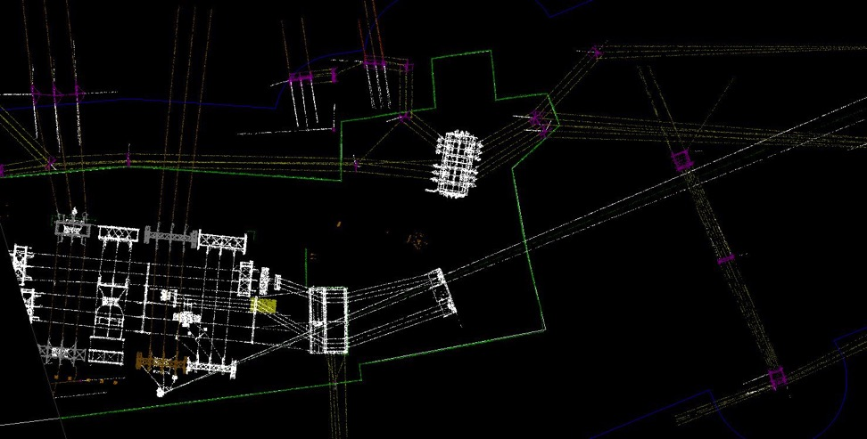

Slide 22
Photogrammetry vs. LiDAR
Notes:
22
Key Model Point Blowup

Slide 23
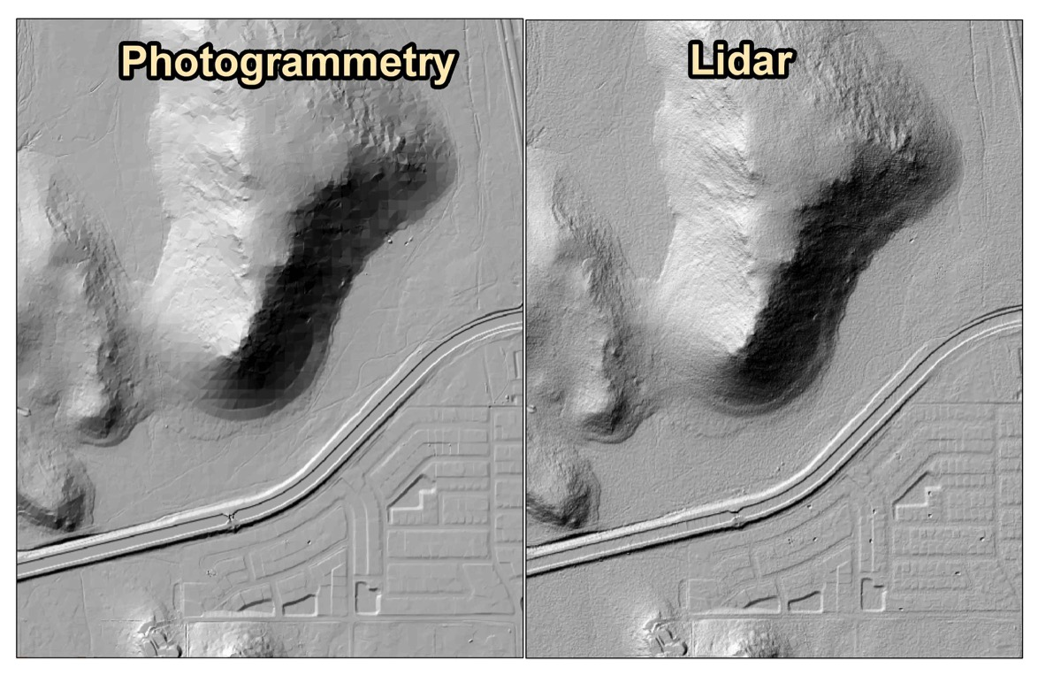
Photogrammetry vs. LiDAR

Slide 24
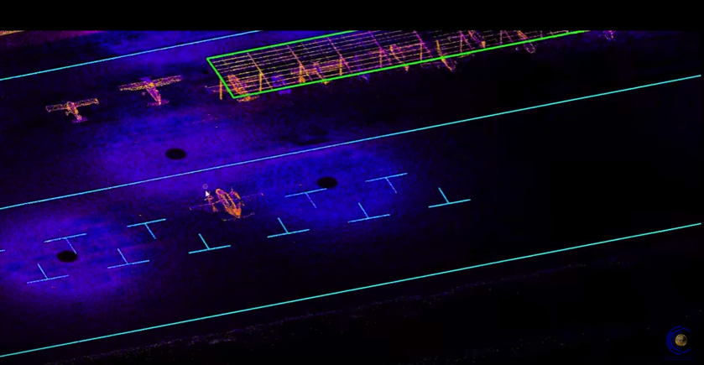
LIDAR Video

Slide 25
LiDAR Products
Pros
Can be less expensive than photogrammetry
Deliveries in a shorter time frame
Minimal Ground Control without truthing
Good solution when no access for ground control
Good data in vegetated areas
Cons
Planimetrics are challenging
10-20 times more data
May contain anomalies
No minor break detail
Not a smooth surface

Slide 26
Questions?
Notes:
26

Slide 27
Thank you very much!
Email with any questions:
Zachary Radel (Sr. Project Manager)
zachary@cooperaerial.com
Philip Gershkovich (President)
phil@cooperaerial.com
WWW.COOPERAERIAL.COM
Notes:
27

